Slide 1
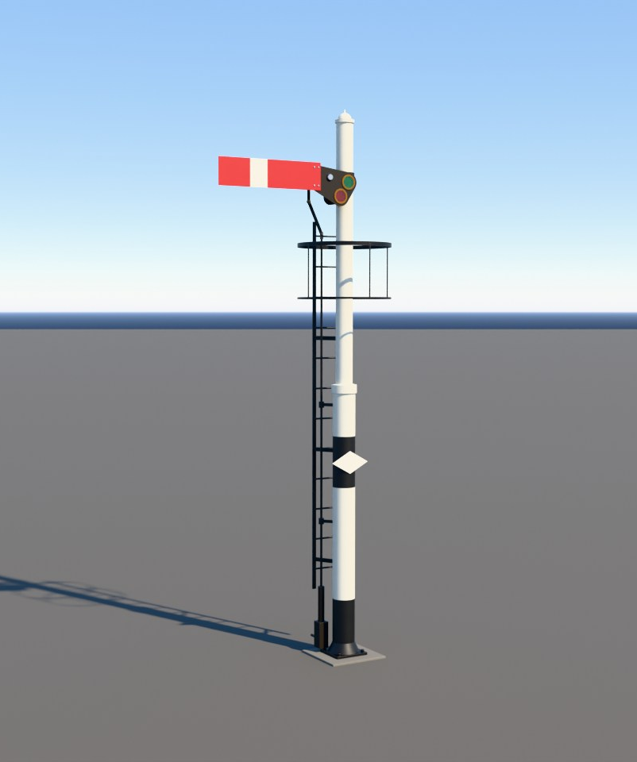
Signals and Signal Boxes
Early Locomotion: a mod for Satisfactory
How steam railways keep trains apart, and how the mod plans to do it.
Early Locomotion project render. Blender model, not yet in the game.

Slide 2
How to read this guide
Decided.
AGREED
Suggested, not confirmed.
PROPOSED
A test number that may change.
PROVISIONAL
Still an open question.
UNDECIDED
A real-world fact.
BACKGROUND
Every idea carries a tag in the top-right corner.
2

Slide 3
The problem
BACKGROUND
No warning: crash
Long stopping distance
How far the driver can see
Trains cannot swerve. They need a long way to stop. Signals keep them apart.
3

Slide 4
Blocks
BACKGROUND
One block
A: Free
B: Occupied
C: Free
D: Free
Split the track into blocks. Keep one train in each block.
4

Slide 5
Signals guard the blocks
BACKGROUND
STOP
CLEAR
CLEAR
Waits
A: Free
B: Occupied
C: Free
D: Free
Arm flat = stop. Arm raised = go.
A signal at the start of each block says stop or go.
5

Slide 6
A semaphore
BACKGROUND
Lamp
Arm
Pivot
Post
Wire
STOP
CLEAR
Arm style (rises or drops): undecided
A semaphore is a post with a moving arm. The arm is the message.
6

Slide 7
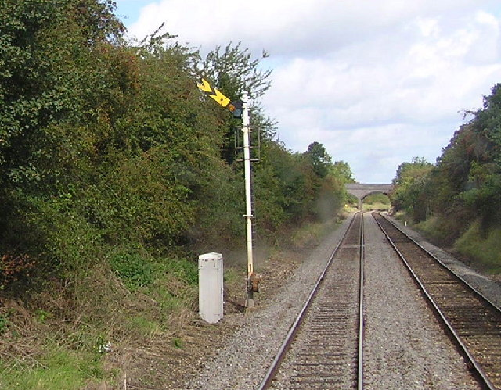
Stop arm and distant arm
BACKGROUND
Stop arm
Distant arm
Richard Dunn, CC BY-SA 2.0. Wikimedia Commons.
STOP
GO
Be ready to stop at the next signal
Next signal is clear
A real distant signal, arm raised.
Night lamps
Stop
Distant warning
Clear
A stop arm orders a stop. A distant arm only warns you.
7

Slide 8
If the wire breaks
BACKGROUND
Wire intact
Wire broken
CLEAR
STOP
The mod's failure rule: undecided (OQ03)
On real railways, a broken wire drops the arm to stop.
8

Slide 9
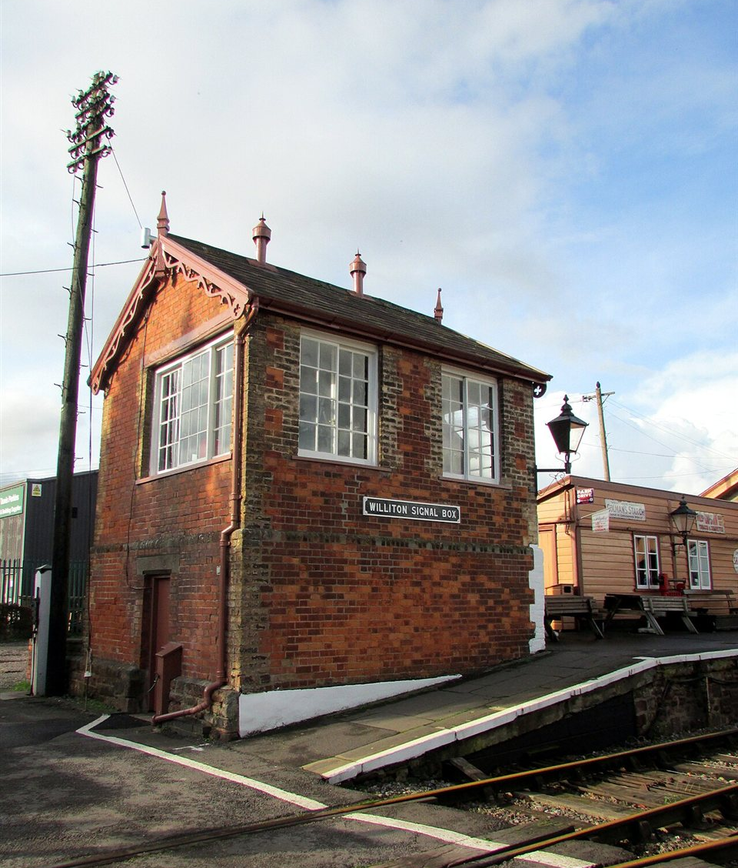
The signal box
BACKGROUND
High windows: a good view of the track
The signaller: works the levers
Lever frame: inside
Reading Tom, CC BY 2.0. Wikimedia Commons.
A signal box is a small building. A signaller works the signals from it.
9

